Slide 1
FitLike
Graphical User Interface

Slide 2
I- Introduction
Why a graphical user interface (GUI) ?
  Non-developer people
  Fast visualisation and treatment of large dataset
Main functions
  Process relaxometric data with custom functions and methods
  Visualise and explore relaxometric data
  Organise and format large dataset
  Fit and export custom models for dispersion data
Modular architecture

Slide 3
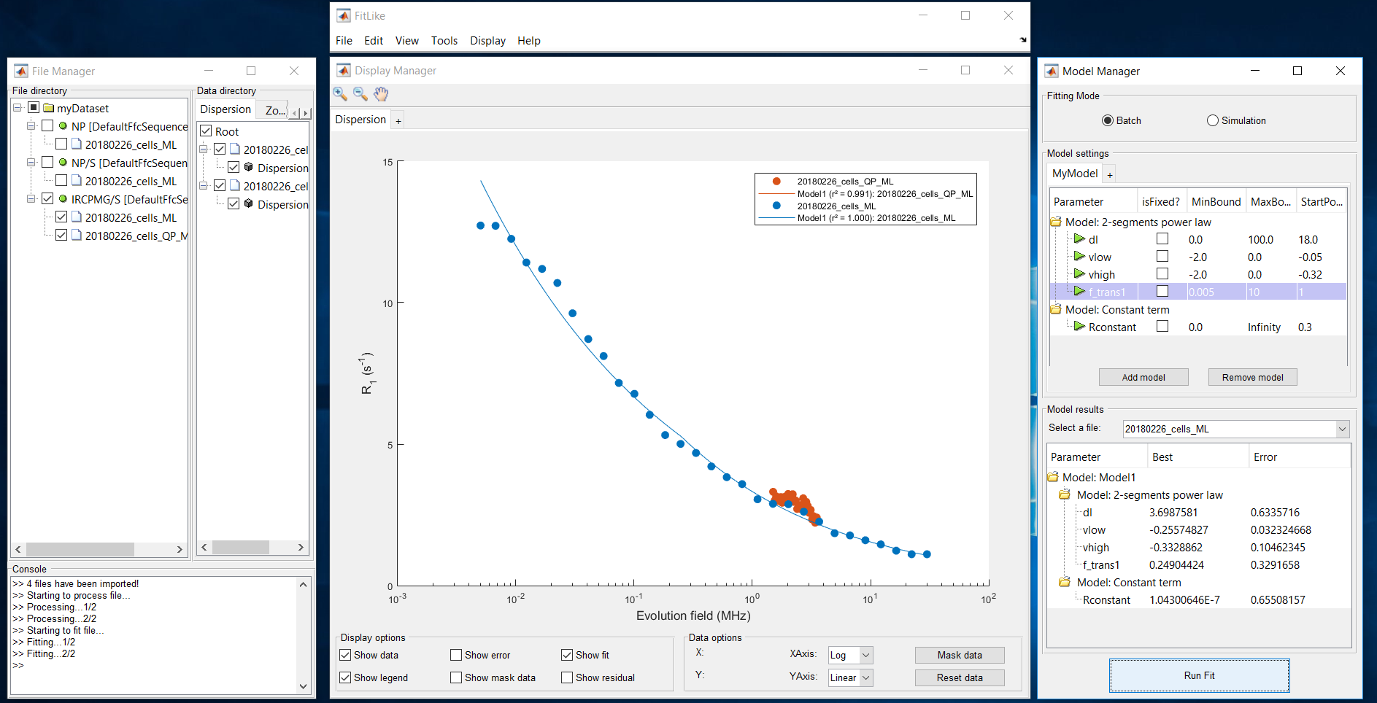
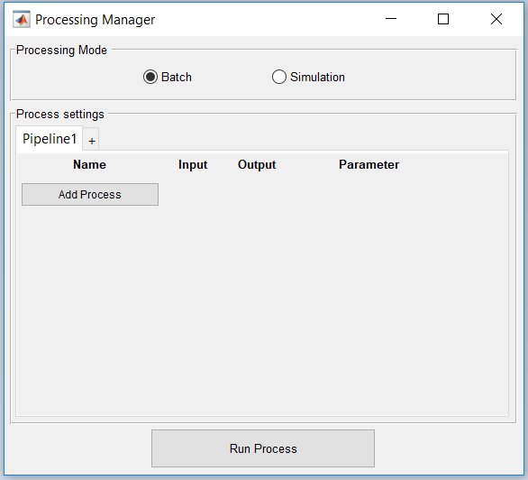
II- GUI Presentation
FitLikeView:
Open/remove file
Save/Export
…
ModelManager:
Manage models
Visualise results
FileManager:
Organise dataset
Explore data
DisplayManager:
Visualise data
Mask data
ProcessingManager:
Manage processing pipeline(s)

Slide 4
III- GUI Architecture
Oriented-Object Programming (OOP) design with a « pseudo MVC » architecture
  « View » classes: FileManager, DisplayManager,…
  « Model » classes: DataUnit, Bloc, Zone,…
  « Controller » class: FitLike
  Process classes: ProcessDataUnit, DataFit,…
« Pseudo MVC » because View classes can be completely independent
Design to be modular and scalable

Slide 5
III- GUI Architecture
FitLike (Controller) is the center of the GUI
FileManager
DataUnit
DisplayManager
Fire data nodes (tree) update
Fire console message
Send data displayed
Fire masked data
Update
data
Fire data selection
Fire data display
Send
data
FitLike
Send pipeline Fire process
Fire process
(give data and process)
Send data processed
ProcessingManager
Fire results display
Send model Fire fit
ModelManager
ProcessDataUnit
DataUnit2DataUnit
* Here we omited FitLikeView (the main menu at the top): fire multiple callbacks to FitLike

Slide 6
III- GUI Architecture – Tab system
The GUI contains a custom tab class system
Fire data display
Send pipeline Fire process
DisplayManager
ProcessingManager
Send data displayed at the selected tab
Send masked data
Send data to selected tab
Manage tab
Manage tab (create, delete)
Send pipeline
Send data displayed
Fire masked data
ProcessTab
DispersionTab
FitLike
ZoneTab
BlocTab
BoxPlotTab

Slide 7
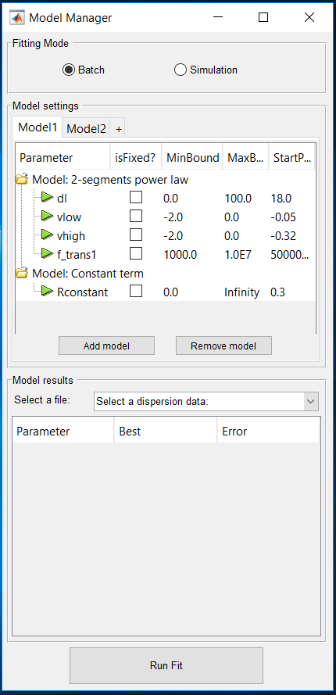
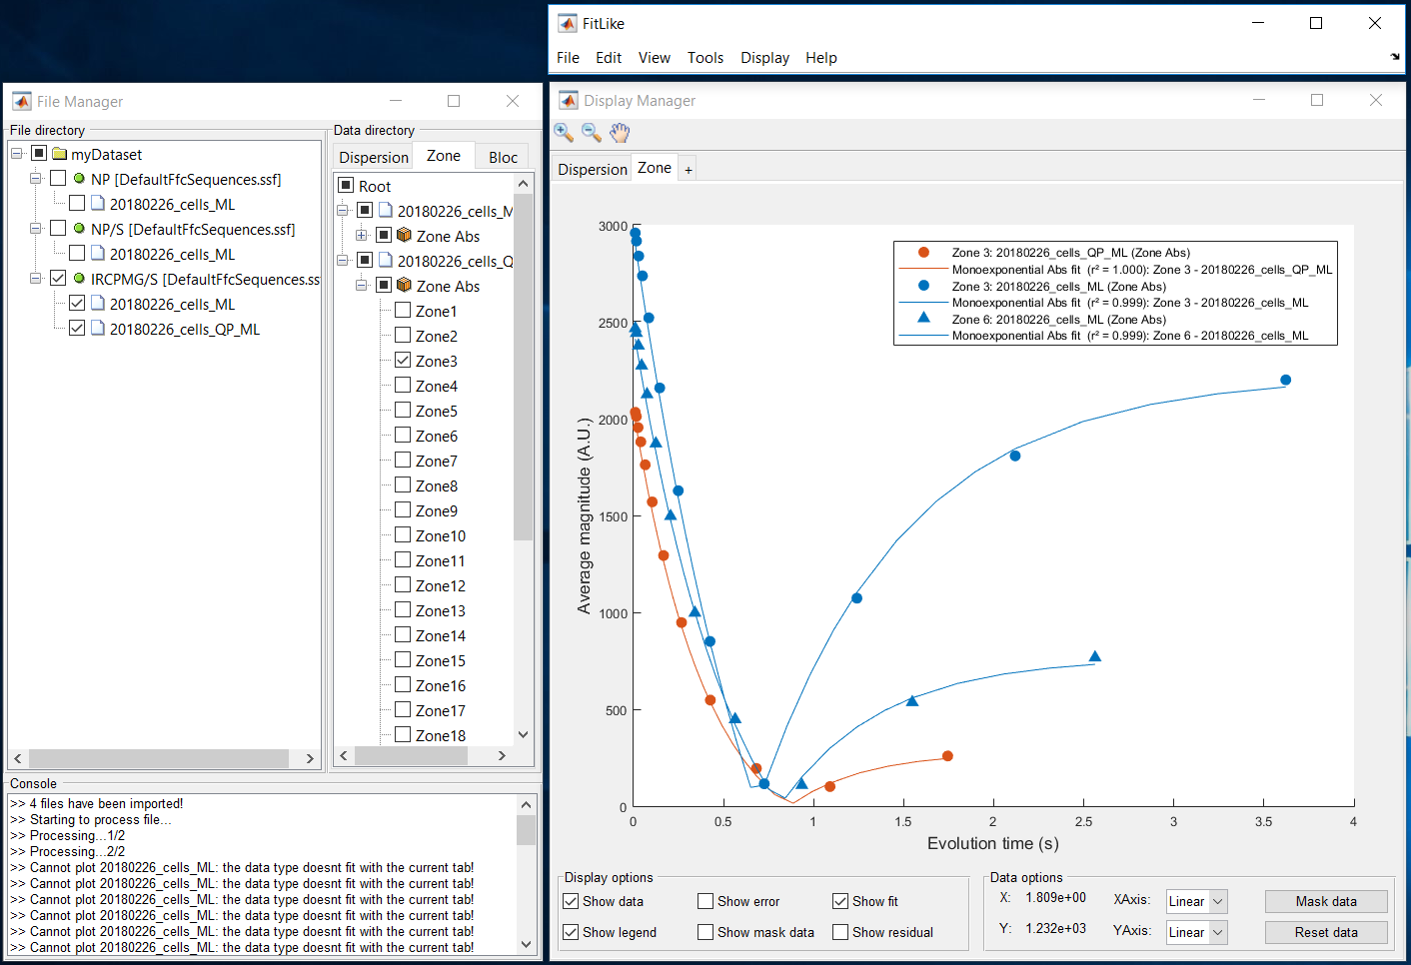
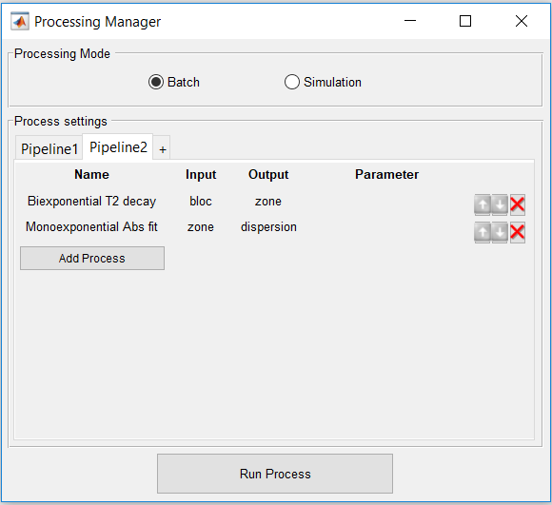
III- GUI Architecture – Tab system
Custom model
Custom data visualisation
Custom pipeline

Slide 8
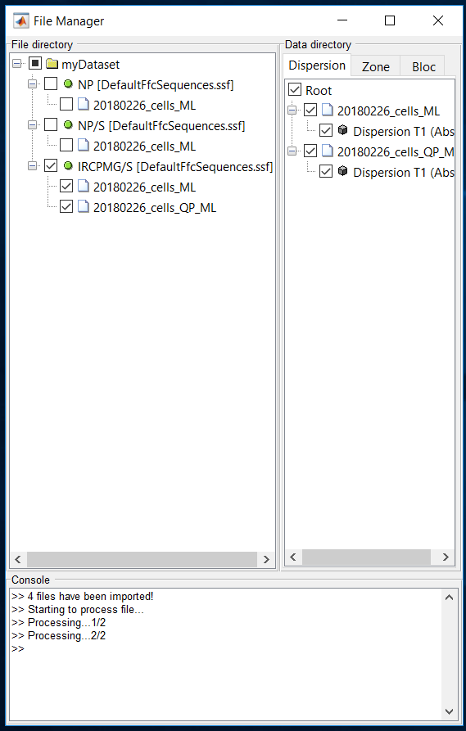
IV- Features (FileManager)
Data organisation
  File directory: Dataset > Sequence > File
  Data directory: Dispersion/Zone/Bloc
Data selection
  File directory: show data contains in files
  Data directory: display data
Rename dataset/sequence/file
Move dataset/sequence/file
Console

Slide 9
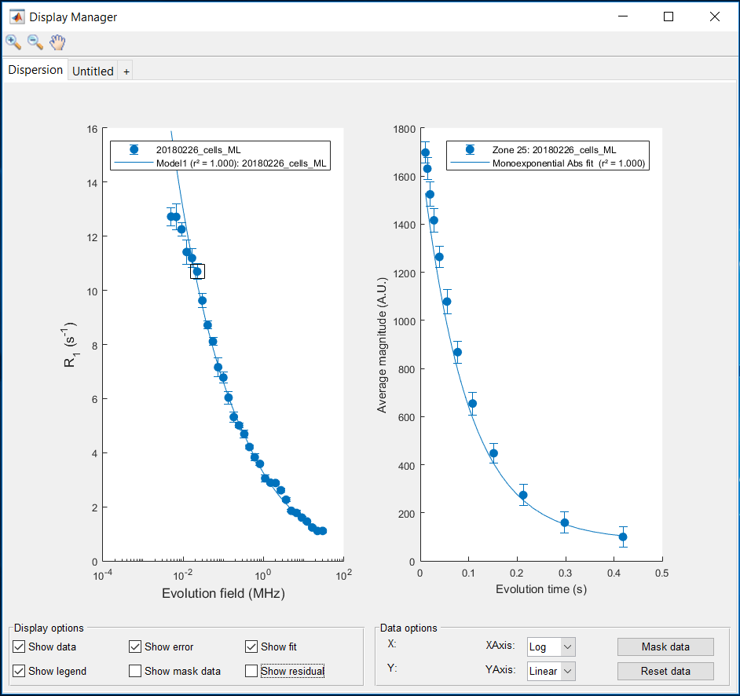
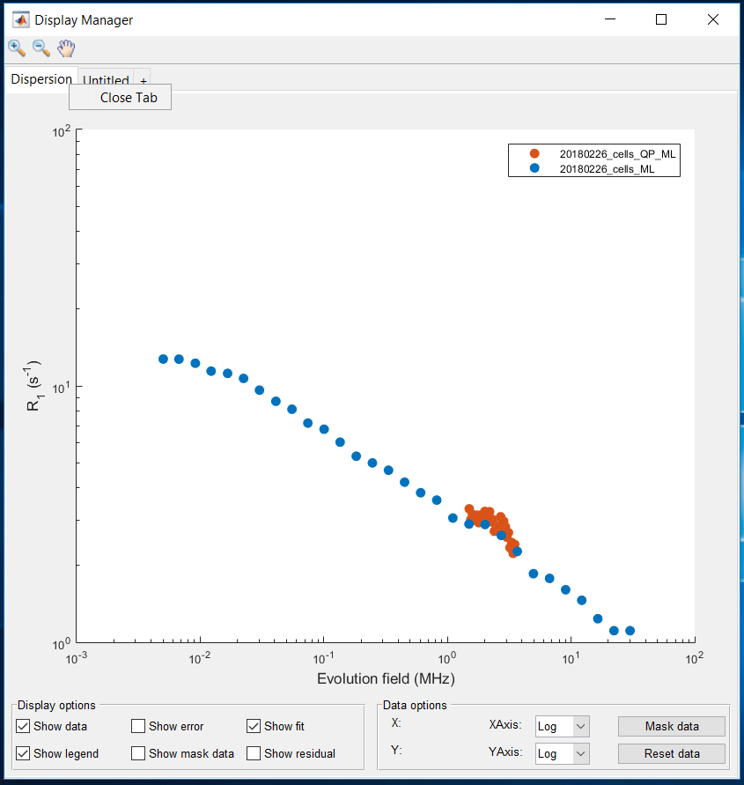
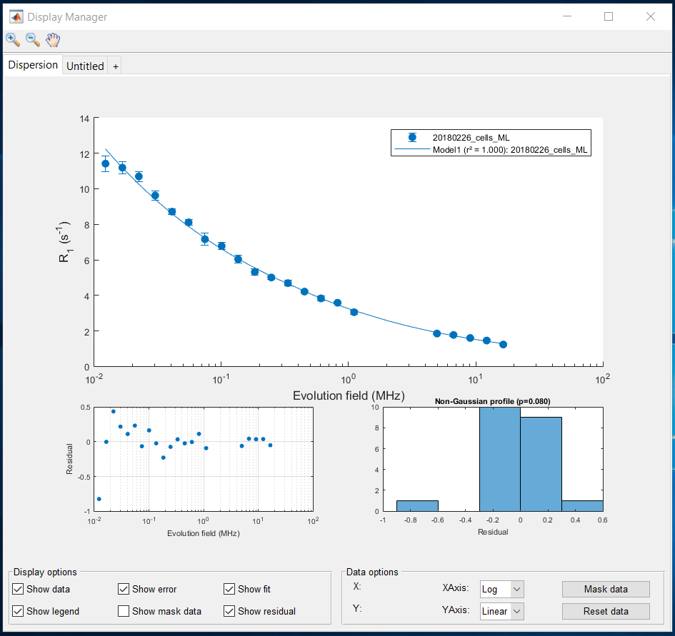
IV- Features (DisplayManager)
Data visualisation
  Dispersion data
  Zone data
  Bloc data (not available yet)
  Others
Visualisation options
  Data/Error/Fit/Mask/Legend/Residuals
  Axis scaling
  Current point
  Zoom/Pan
Mask data
Quick visualisation of parent data (zone/bloc)

Slide 10
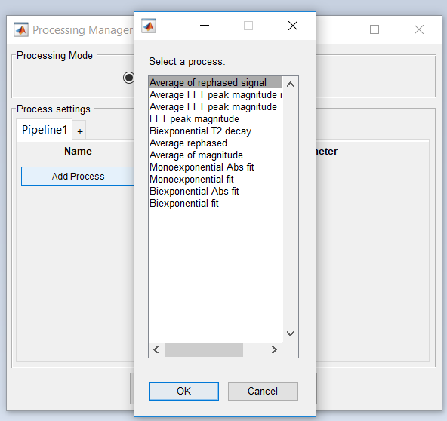
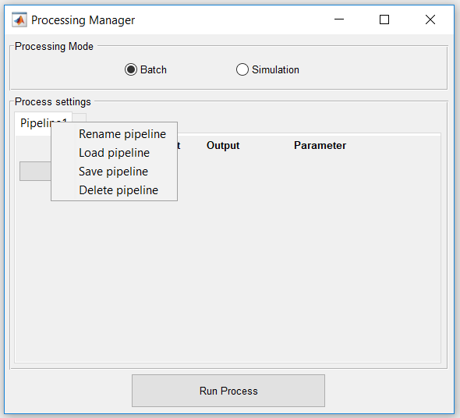
IV- Features (ProcessingManager)
Two mode options
  Batch: One Pipeline/Multiple Files
  Simulation: Multiple Pipeline/One File (not available)
Manage pipeline(s)
  Add/Remove
  Save/Load
  Rename
Custom pipeline
  Add/Remove process
  Move process
  Manage process parameters (not available)

Slide 11
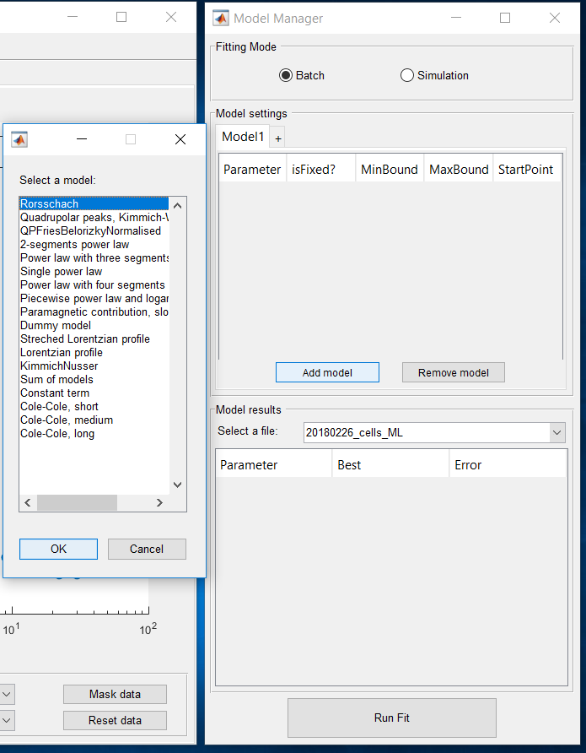
IV- Features (ModelManager)
Two mode options
  Batch: One Model/Multiple Files
  Simulation: Multiple Models/One File (not available)
Manage model(s)
  Add/Remove
  Save/Load
  Rename
Custom model(s)
  Add/Remove functions
  Manage boundaries and start point
  Manage fit parameters (not available)
Visualise fit results

Slide 12
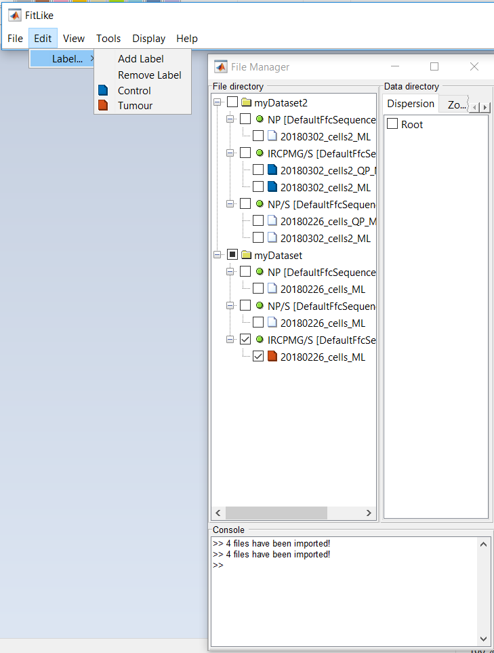
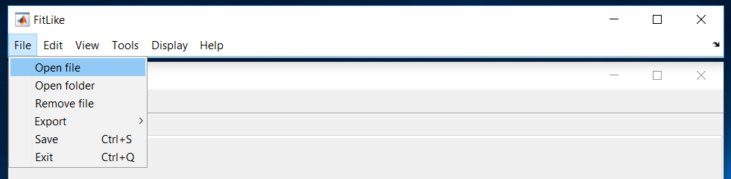
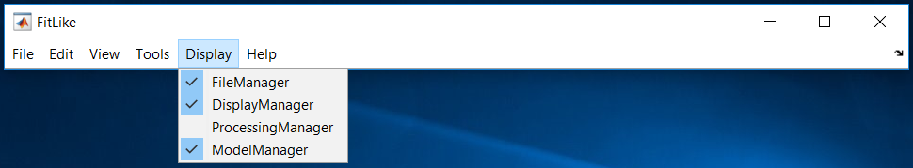
IV- Features (FitLikeView)
File importation
  Stelar files (.sdf, .sef)
  Saved dataset (.mat files)
Save/Export
  Export dispersion data
  Export fit results
  Export current display window (figure)
  Save dataset
Set windows visibility
Add/Remove labels (not totally functionnal)

Slide 13
IV- Next Features
Merge files
Access fit parameters (algorithm, tolerance,..) for all process, including dispersion fit
Export fit results
Bloc tab
Labeled curves and use them for statistical analysis (boxplot, anova,…)
And after? → Ideas are welcomed! (During this day or later in GitHub)

