Slide 1
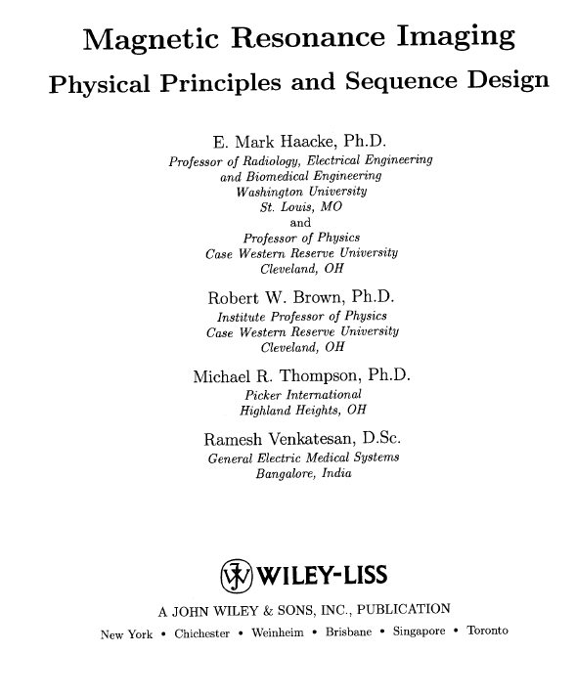
Testo di riferimento

Slide 2
Magnetism in medicine: some historical hints

Slide 3
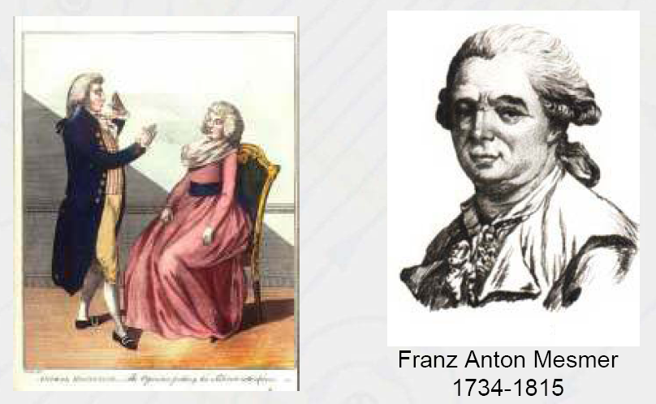
Magnetic therapy through the ages
a medical doctor, german, lived in Austria, Germany, France
He studied the influence of planets and living beings on sick persons
Animal gravity : the forces among things and living beings penetrate the body
and harmonize it. When they are contrasted, a disease is developed
Mesmer’s magnetic stones, animal magnetism, “magnetic” fluid
He founded (in his house) the Landstrasse nursing home
A book : Mémoire sur la découverte du magnétisme animal

Slide 4
Magnetic therapy through the ages
Dr (!!!) James Graham
(1745–1794)
He left medical school without taking a degree
elaborated electro-magnetic apparatus, treated patients with musical therapy
sold medicines such as “Electrical Aether” and “Nervous Aetherial Balsam.”
converted a large house in an opulent section of London into Temple of Health.
Young woman involved : Emma Lyon, in later years wife of Sir William
Hamilton and Lord Nelson's lover.
The centerpiece of the Temple of Health was the 'Celestial Bed' (fee of £ 50 a night)

Slide 5
Magnetic therapy through the ages

Slide 6
Magnetic therapy mostly still not FDA approved (from the web, 2008)….
* Claims about magnetic therapy are based on the fact that some cells and tissues
in the human body give off electromagnetic impulses.
* Some practitioners think the presence of illness or injury disrupts these fields.
* Magnets produce energy fields of different strengths, which proponents believe
can penetrate the human body, correcting disturbances and restoring health to the afflicted systems,
organs, and cells. Proponents claim magnetic therapy can relieve pain (caused by arthritis,
headaches, migraine headaches, and stress and can also heal broken bones, improve circulation, reverse degenerative diseases, and cure cancer).
* One small but well-publicized randomized clinical trial conducted at the Baylor College of Medicine : the permanent placement of small magnets reduced pain in people who had recovered from polio.
…… more about FDA position
The FDA has not approved the marketing of magnets with claims of health benefits
According to the FDA, magnets used for magnetic therapy are generally considered safe.
However, implantable medical devices such as pacemakers,
defibrillators, or infusion pumps may be adversely affected by magnets.
FDA approved in 2011 Pulsed electromagnetic field therapy (PEMFT),
also called pulsed magnetic therapy, pulse magnetotherapy,
or PEMF, is a reparative technique most commonly used in the field of orthopedics
for the treatment of non-union fractures, failed fusions, congenital pseudarthrosis and depression. I

Slide 7
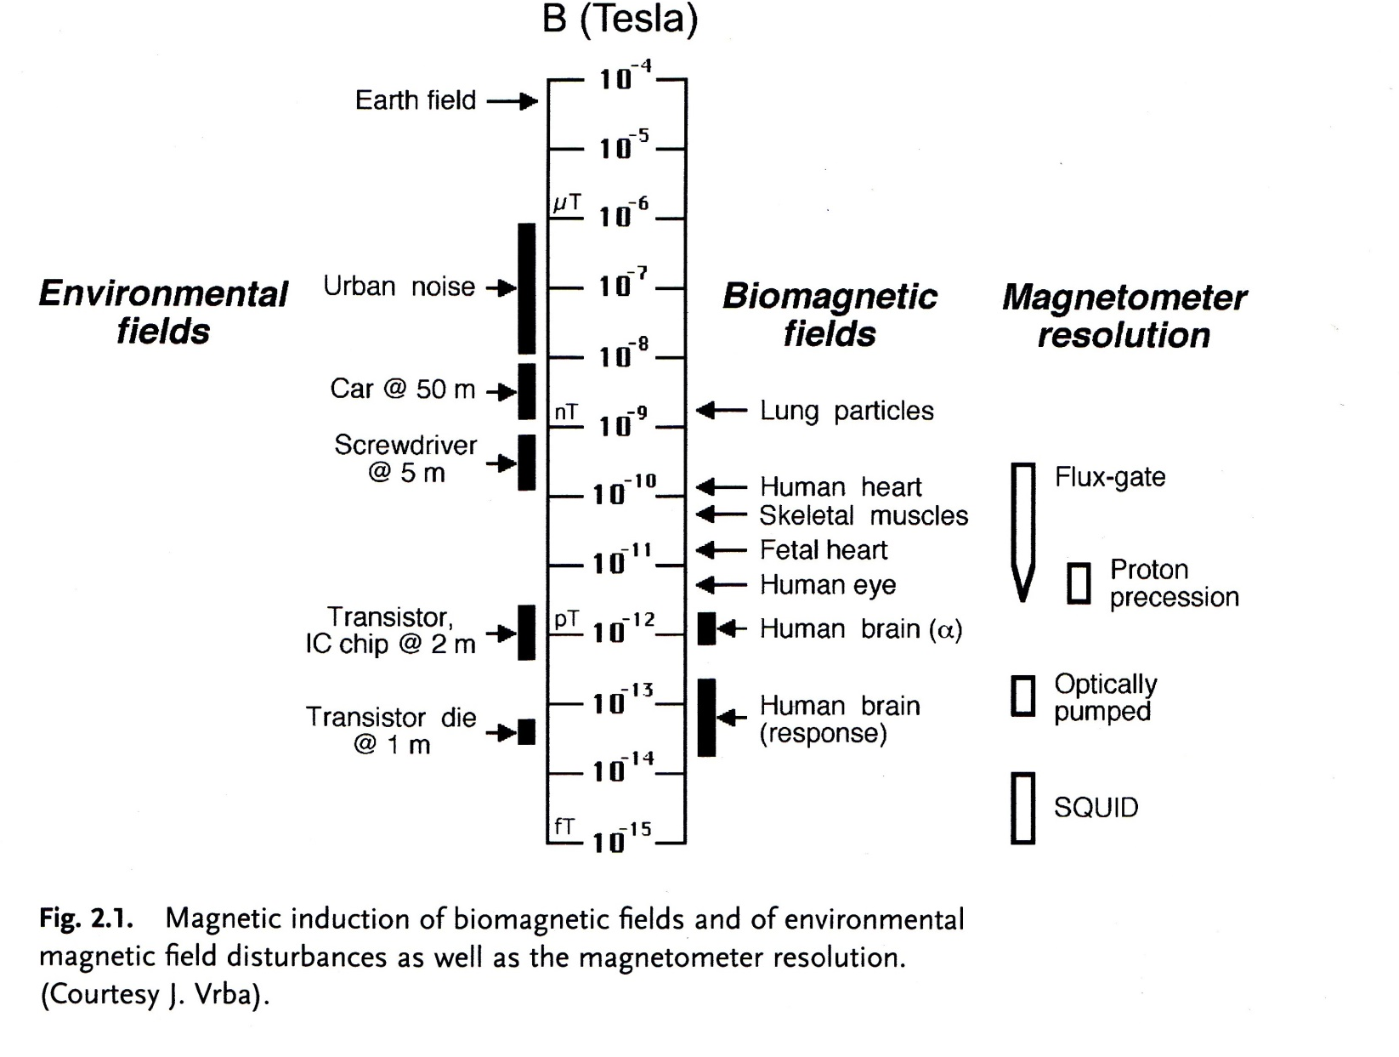
More serious stuff … biomagnetic fields

Slide 8
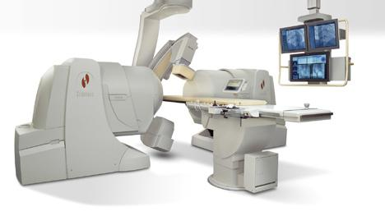
Magnetic navigation (FDA approved)
Magnetic navigation system
Niobe system by Stereotaxis inc
Two large permanent (H~0.1÷0.2 T) magnets guide :
* a magnetic tipped-guide wire
* an electrophysiology mapping catheter
through the patient’s vascular system
Applied to :
diagnosis of congenital heart disease in neonates
cardiac bypass
- repair of chronic occlusions
- drug delivery of angiogenic factors to damaged heart

Slide 9
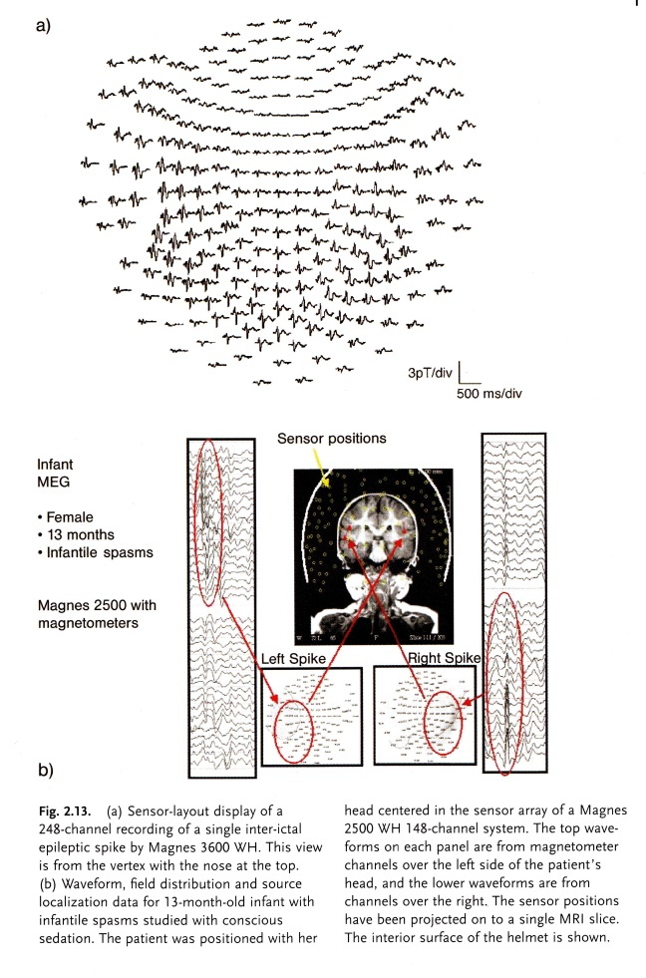
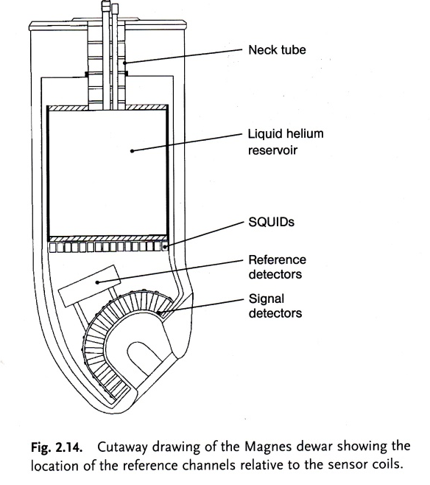
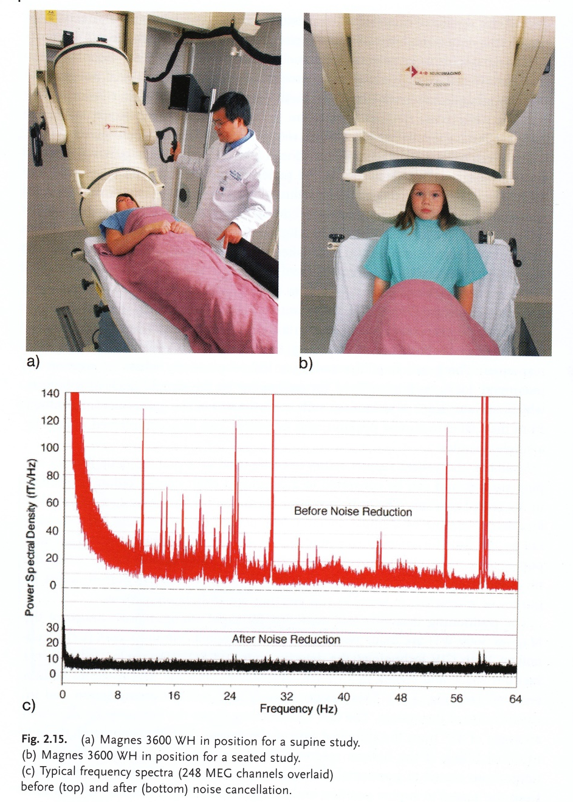
MEG (FDA approved)
Magneto encephalography (MEG)

Slide 10
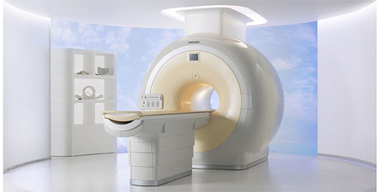
Magnetic Resonance Imaging (MRI)
MRI Timeline
1946 MR phenomenon - Bloch & Purcell
1952 Nobel Prize - Bloch & Purcell
1950-70 NMR developed as analytical tool
1972 Computerized Tomography
1973 Backprojection MRI - Lauterbur
1975 Fourier Imaging - Ernst
1977 Echo-planar imaging - Mansfield
1980 FT MRI demonstrated - Edelstein
1986 Gradient Echo Imaging - NMR Microscope
1987 MR Angiography - Dumoulin
1991 Nobel Prize - Ernst
1992 Functional MRI
1994 Hyperpolarized ¹²⁹Xe Imaging
2003 Nobel Prize - Lauterbur & Mansfield
Typical MRI apparatus for
clinical use, magnetic field
H = 1.5 Tesla

Slide 11
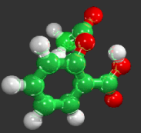
Magentic Nanoparticles in biomedicine
nanoparticles
pollen
Human hair
Gene (width)
Bacteria
0.1 nm
1 nm
10 nm
100 nm
1 m
10 m
100 m
Aspirin molecule
Proteins
Cells
Virus
DNA

Slide 12
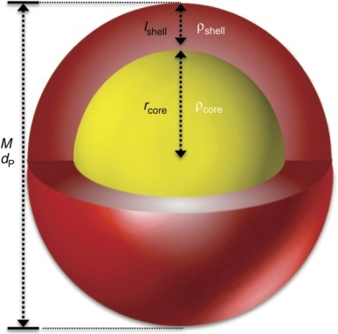
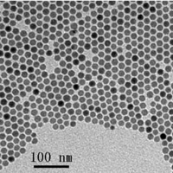
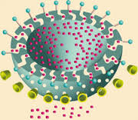
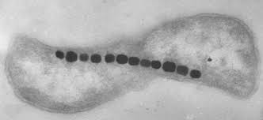
What are magnetic nanoparticles ?
Simplest form : magnetic core (often simple ferrites) + organic coating
TEM
* Natural NPs (magnetosomes)
* Hollow / different shape
High monodispersity

Slide 13
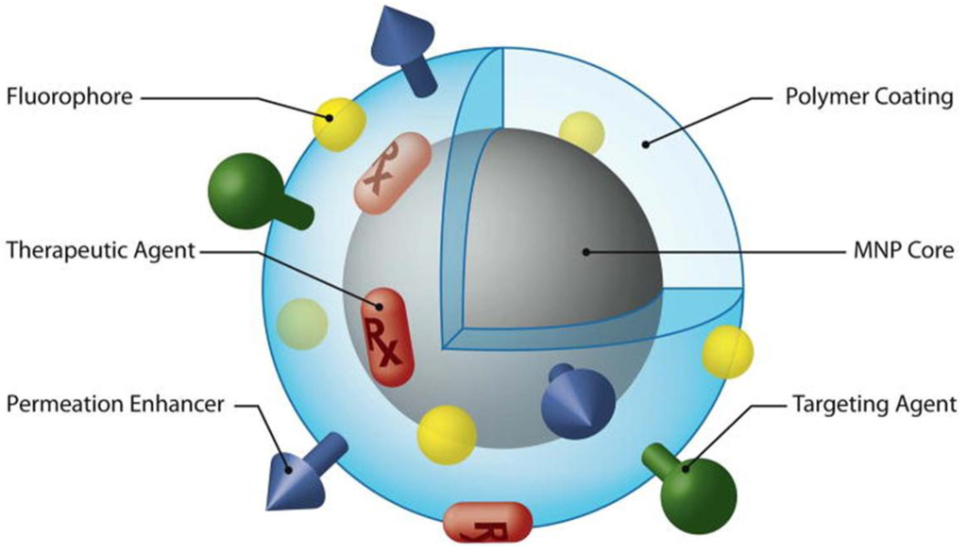
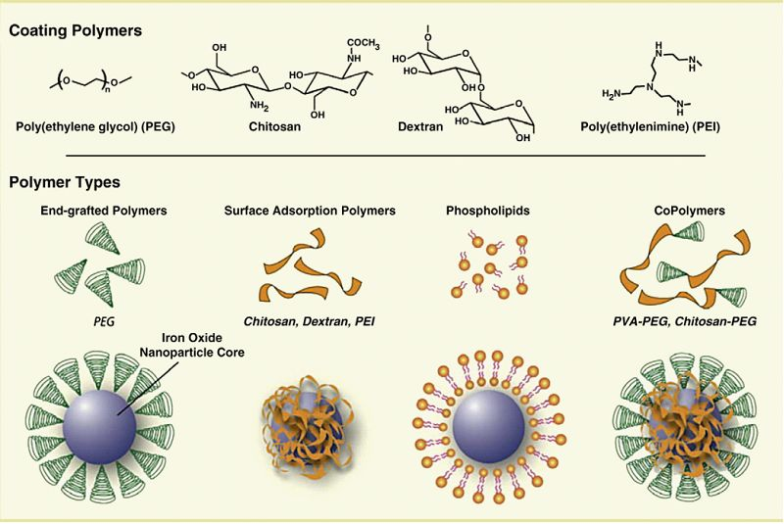
…….for biomedical applications….
* Kind of coating : biocompatibility (and targeting)
* Surface functionalization for cancer targeting
* Fluorescent/luminescent molecules
* Drugs “attachment” or “inclusion”
Theranostics

Slide 14
Mechanisms and magnetism
Sensing
(MRI, Sentimag, MEG-SQUID,…)
Moving
(navigation)
Heating
(Magnetic
Hyperthermia)

Slide 15
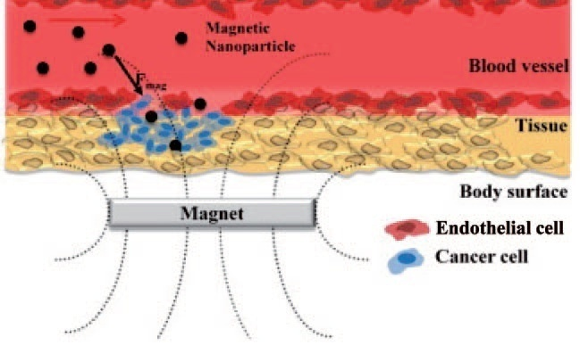
Magnetic transport (preclinical)
IV injection +
local drug release
(under pH change or
external stimulus)

Slide 16
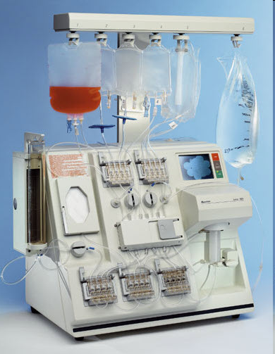
Magnetic cell selection (FDA approved)
Isolex 300i
magnetic Cell Selection system
(from Baxter)
…. for removing tumor cells in stem cell transplants.
Monoclonal anti-tumor antibodies (anti-CD34) conjugated to magnetic polystirene microspheres (Dynabeads M-450) to purificate bone marrow from tumor cells

Slide 17
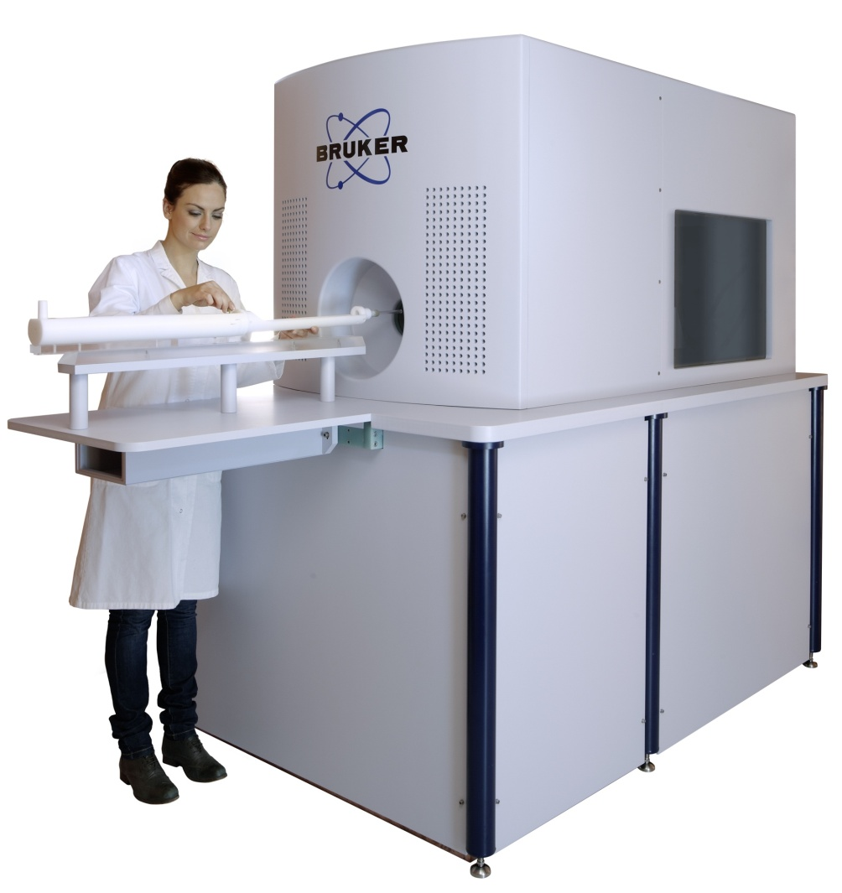
Magnetic Particle Imaging – MPI (preclinical)
1st MPI system
(Bruker-Philips, 2013)
It images the distribution of
MNPs in biological tissues
http://www.philips.com/e/imalytics/productsnew/magneticparticle.html

Slide 18
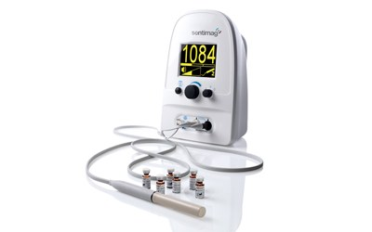
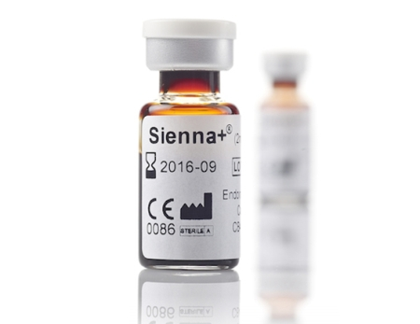
Today SENTIMAG : a sensitive susceptometer
The Sentimag® is a Class IIa device, CE-approved for marketing and sales in Europe, and TGA-approved for Australasia.
Sentinel lymphnodes
Technique (e.g. breast
cancer surgery)
MNPs

Slide 19
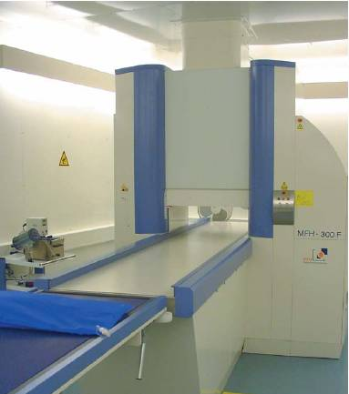
Magnetic Fluid Hypertheria tumor treatment
Magnetic Fluid Hyperthermia (MFH) or Magnetothermia
Heating through application of AC magnetic field via activation of 12 nm amino-silane coated Fe₃O₄ MNP directly implanted in the tumour mass at high doses (ca. 50 mg/cm³)
Typically : ν ~ 100 kHz, amplitude 10 kA/m
Minor side effects
H₀f ≤ 4 10⁹ Am⁻¹s^{-1 (*)}
50 kHz ≤ ν ≤ 1 MHz
(*) Depending on the radius of the exposed region
RF coil
Typical values of the reported specific loss of power, SLP or SAR (the energy converted into heat per mass unit) are : 10÷200 W/g
Exceptions :
- 35 nm bacterial magnetosomes (960 W/g at
410 KHz and 10 kA/m)
- 16 nm γ-Fe₂O₃ N P ( 1650 W/g
at 700 kHz and 24.8 kA/m, 300 W/g at 11 kA/m)
Head position

